Slide 1

AegisMind : Cyber Thread Detection using Agentic AI (SDG 9 : Industrial, Innovation and Infrastructure)
Nishant Dakua - 23106014
Arif Choudhary - 23106054
Rushi Choraghe - 23106033
Aryan Kotur - 23106094
Project Guide
Mr. Vijesh Nair
Academic year 2025-26
Notes:
1

Slide 2
Introduction
Current Limitations :
Reactive systems that respond only after an attack.
Limited protection against unknown zero-day vulnerabilities.
Heavy reliance on human intervention, leading to alert fatigue and slower response times.
Inability to adapt quickly to novel attack vectors.
Introducing AegisMind :
AegisMind is a groundbreaking, AI-powered agentic layer designed for autonomous cyber defense and counterattack. It's a plug-and-play solution that seamlessly integrates into any digital environment.
Leverages Large Language Model (LLM) reasoning for complex threat analysis.
Utilizes Deep Reinforcement Learning (DRL) for unparalleled adaptability.
Features memory-driven evolution, learning from every interaction.
Deployable via SDK to websites, APIs, and SaaS products.
Notes:
2

Slide 3



Problem statement
How can we defend against AI-powered, zero-day cyber threats without relying on static rules?
Can we build a system that simulates attacker behavior and reasons in real time?
What if cyber defense could learn, adapt, and evolve like a living system?
Can we create an autonomous, plug-and-play AI shield for any digital platform?
AegisMind & UN Sustainable Development Goals
Goal 9: Industry, Innovation & Infrastructure
Goal 16: Peace, Justice & Strong Institutions
AegisMind fosters resilient infrastructure by providing advanced cyber defense, enabling innovation without security compromise.
By securing digital systems, AegisMind contributes to stable, secure institutions and a more peaceful cyberspace.
Goal 4: Quality Education
AegisMind's adaptive learning capabilities implicitly contribute to knowledge systems, securing educational digital platforms and data.

Slide 4
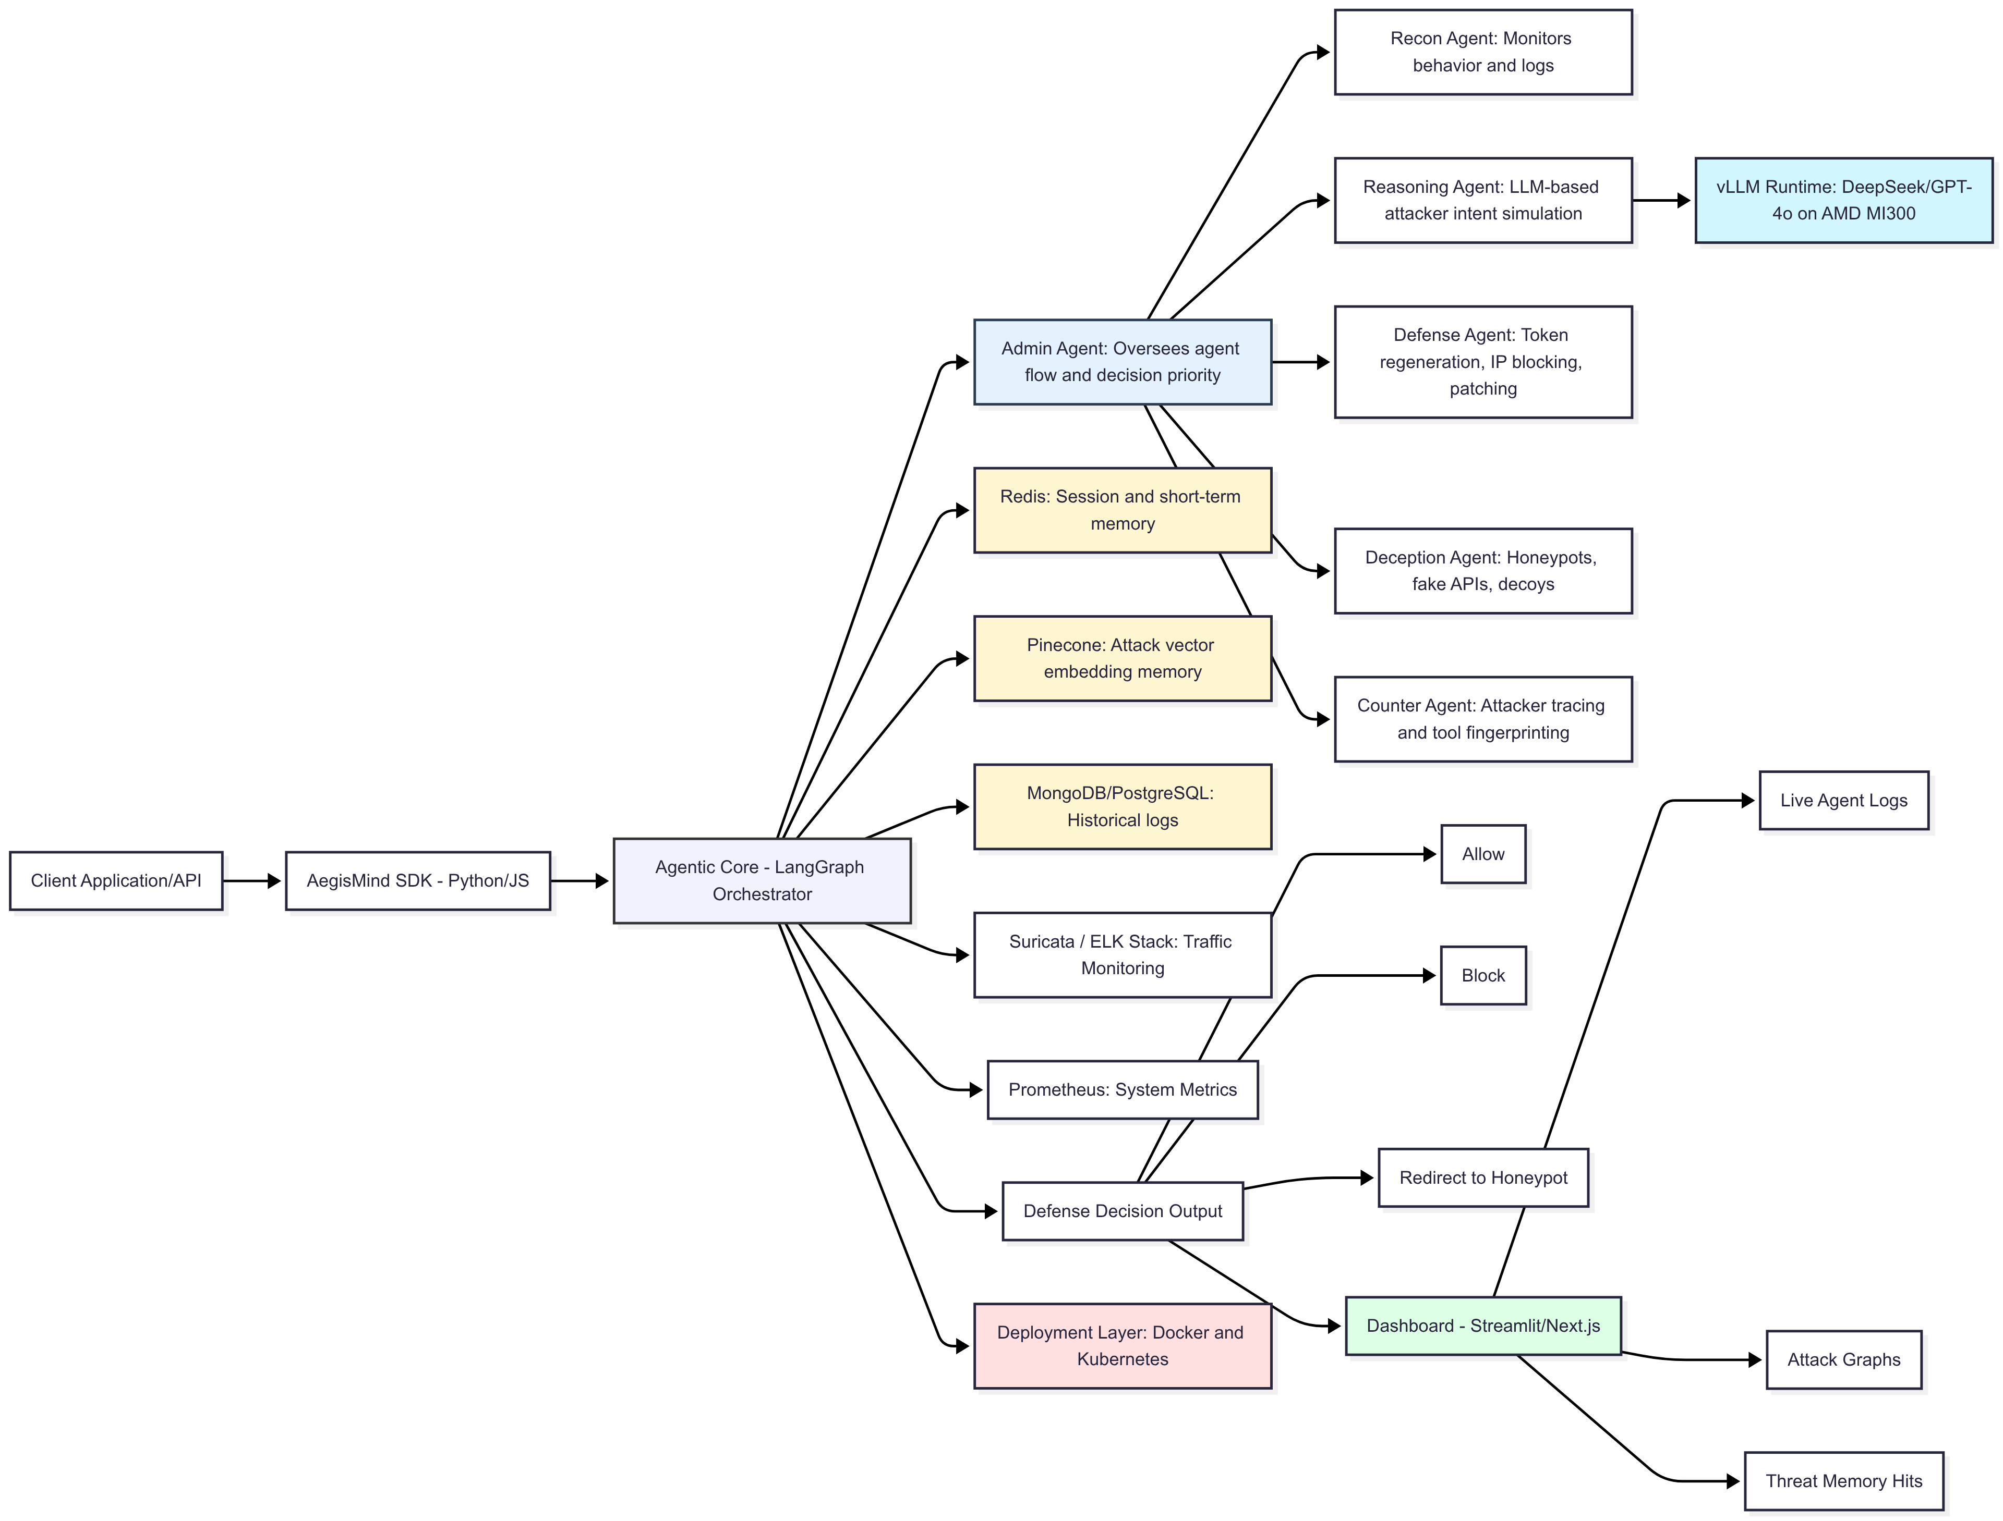

Overview of System Design
Notes:
4

Slide 5
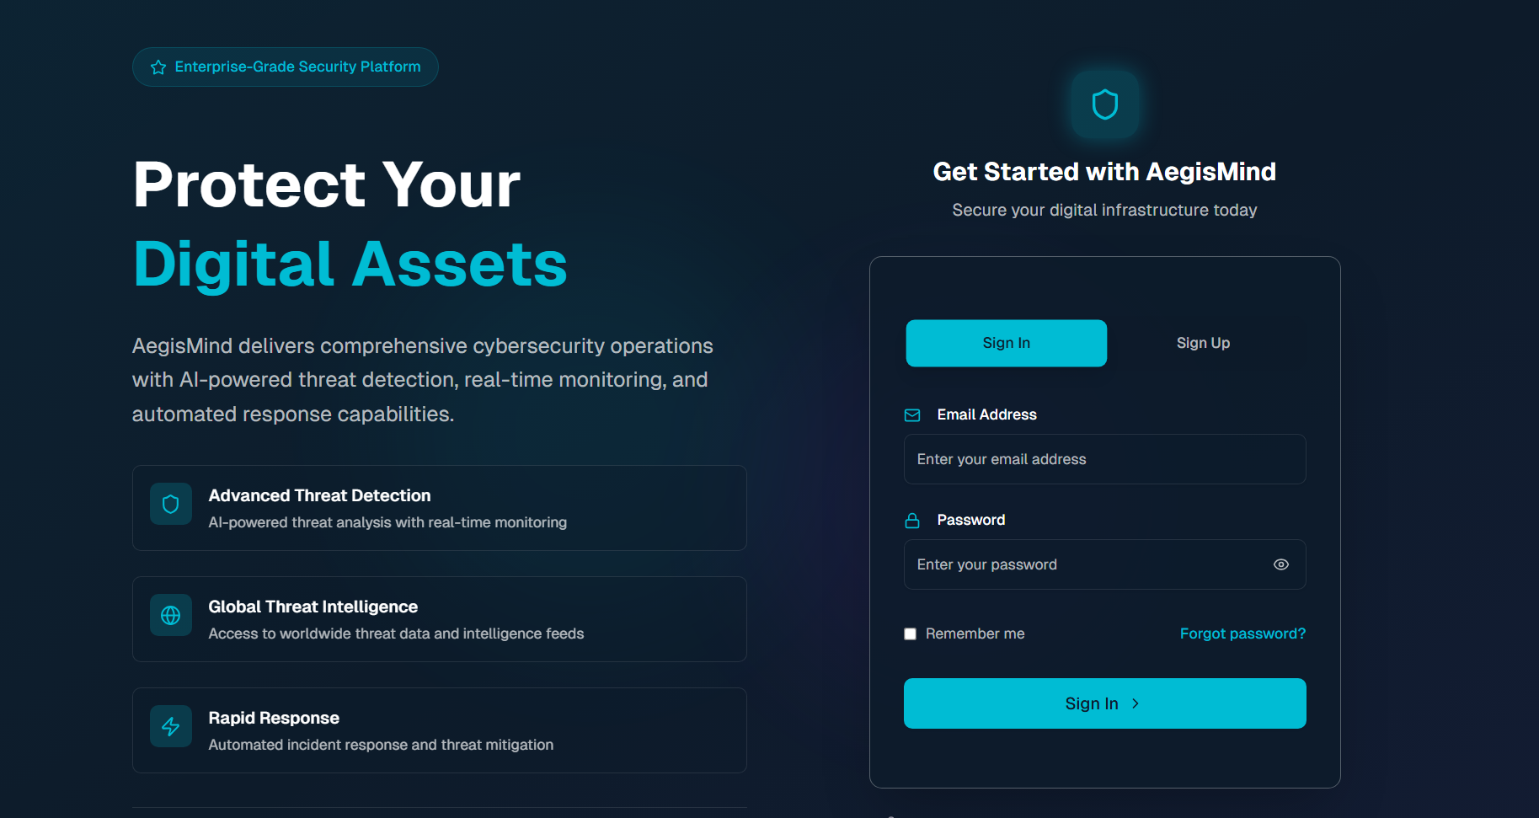
Implementation
LOGIN AND SIGN UP PAGE

Slide 6
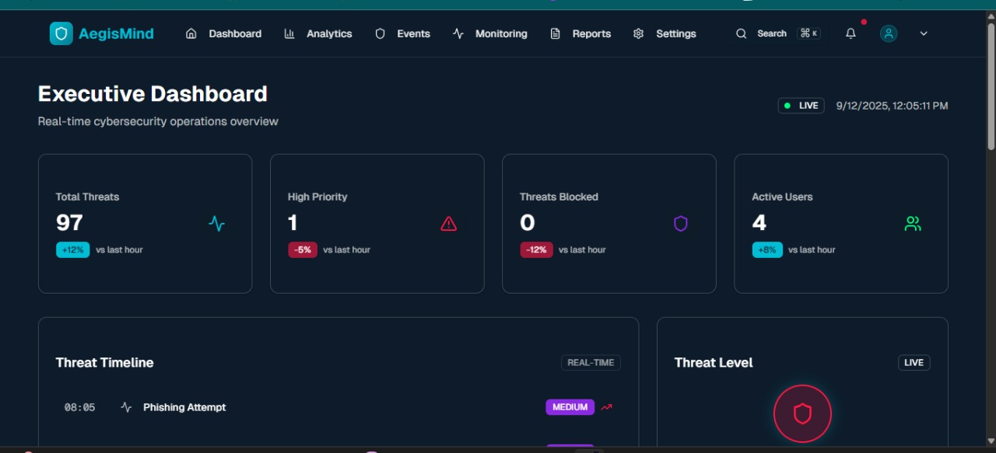
Dashboard with all details real time thread details

Slide 7
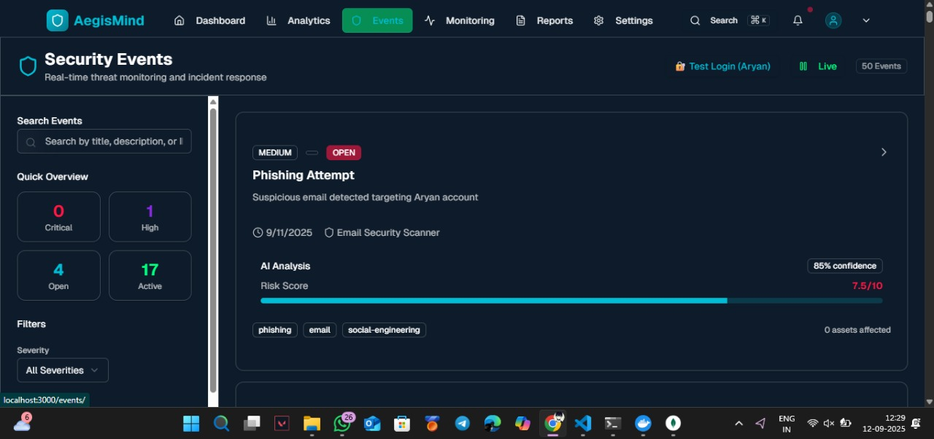
All Security Event

Slide 8
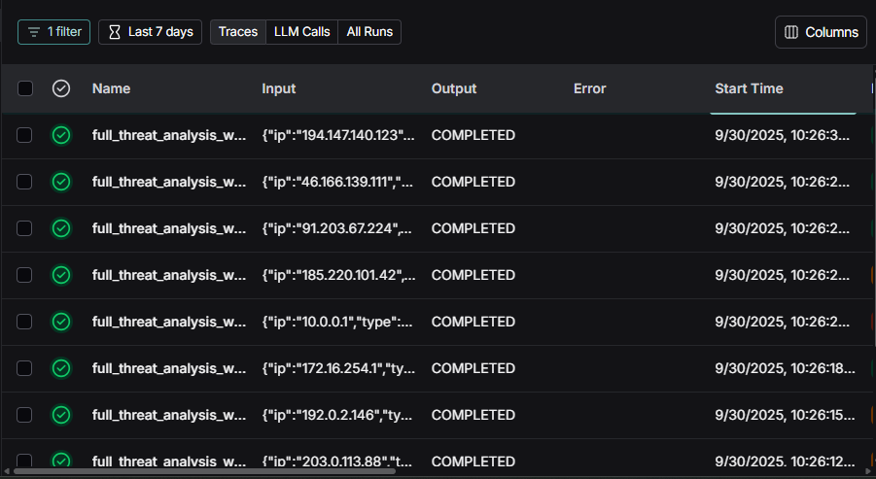
All the Analysed Thread

Slide 9
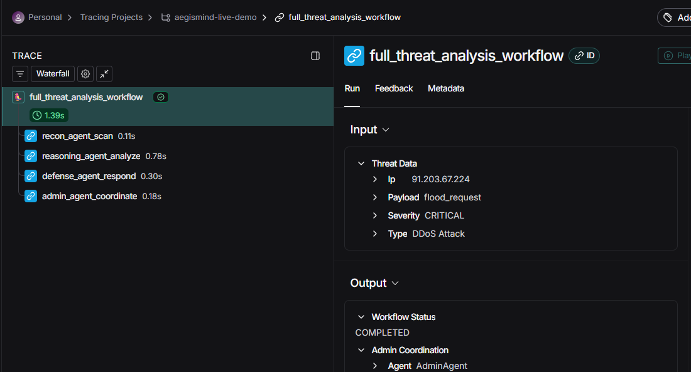
Detail Analysis

Slide 10
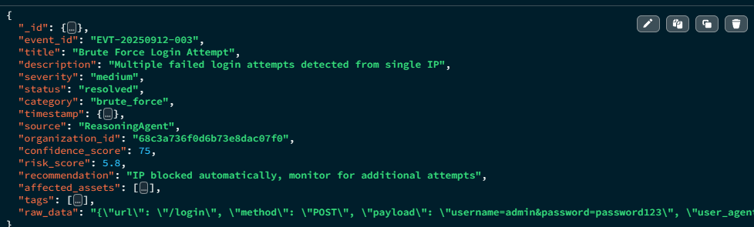
Stored thread data

Slide 11
Literature Review
“Design of an autonomous cyber defence agent using hybrid ai models.”, IEEE
Hybrid AI agent combines DRL, LLMs, and rules to defend cyber networks autonomously.
Tested in CybORG, the agent defends against red team strategies using monitoring and decoys.
Lacks real-world deployment; evaluation limited to simulated CybORG test environments only.
“Game Theory Meets LLM and Agentic AI: Reimagining Cybersecurity for the Age of Intelligent Threats.”
Traditional cybersecurity methods are failing against advanced, AI-powered threats due to their reactive and static nature.
The research also explores how AI agents, working in multi-agent systems, can revolutionize game theory itself by creating more realistic models of bounded rationality and complex interactions, while also highlighting the critical need to address ethical considerations like accountability and bias in these autonomous systems.

Slide 12








Technology Stack
Frontend
Backend
Agent Logic
AI Models
Next.js
Flask
vLLM with DeepSeek 70B
Python + LangGraph
Monitoring
Storage
Deployment
Redis, Pinecone,
MongoDB
Suricata, ELK,
Prometheus
Docker & Kubernetes
LLM Reasoning
DRL Adaptability
Advanced language models enable complex threat analysis and decision-making, understanding nuanced attack patterns.
Deep Reinforcement Learning allows AegisMind to learn and adapt autonomously to evolving cyber threats in real-time.
Vector Memory
Utilizes vector databases for efficient long-term memory, enabling historical analysis and predictive threat intelligence.
Notes:
12

Slide 13
Thank You...!!
Notes:
13

